Slide 1



Data Management
Techniques

Slide 2
Introduction
1

Slide 3
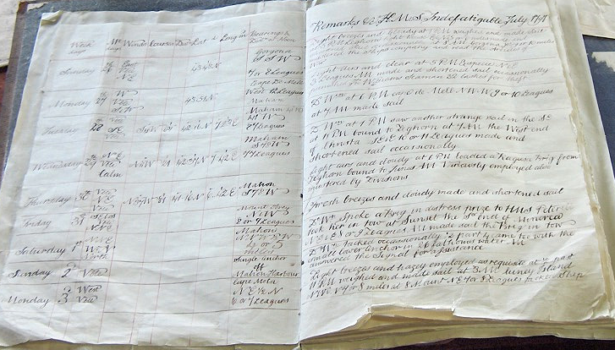
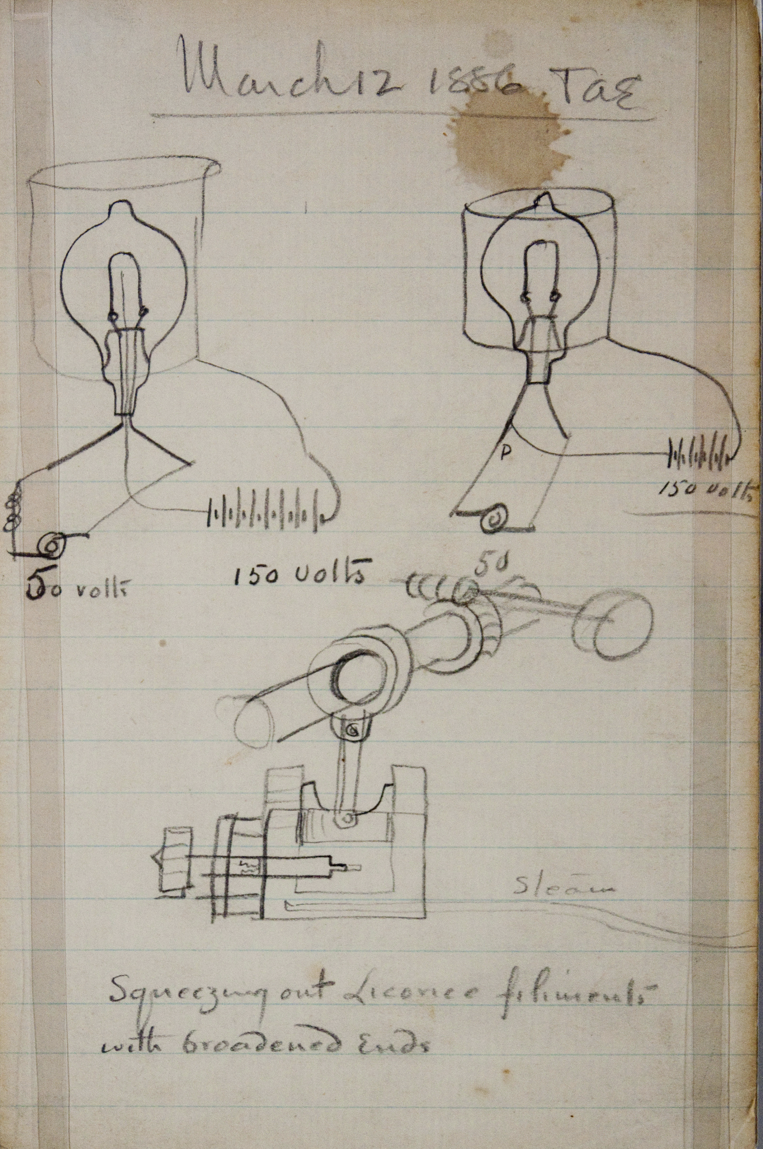
Notes:
Let’s start by asking the question, “what is data management”?
In many respects data management is nothing new.
The detailed notebooks of Edison and the meticulously kept logs of journeys by ship are fine examples.

Slide 4
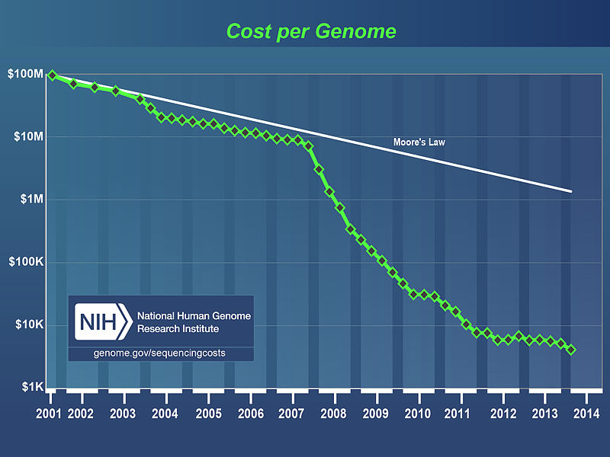
Notes:
But safeguarding a collection of notebooks presents one kind of challenge.
The explosion in the amount of data generated globally presents a different kind of challenge.
Just look at this plot that shows the rapidly declining cost of sequencing a Genome.
The cost of storage, meanwhile, is more closely following the Moore’s Law line.
In simple terms, the cost of storage simply isn’t declining as fast of the cost of sequencing.

Slide 5
Data Management
Notes:
Dealing with all this data becomes a real challenge.
So a new activity is born: “Data management”.
Data management is about:
The safe storage of research data.
Effective collaboration.
Doing the right thing with data given in confidence.
Sharing your data to build your profile, invite scrutiny, and to further research.

Slide 6
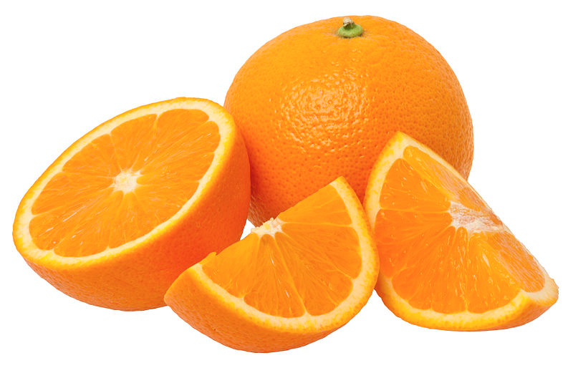
Notes:
It’s about squeezing every last drop of value out of something which is:
costly and time consuming to collect
costly to store
and costly to reproduce

Slide 7
“The central aim is that sufficient materials and data are retained to justify the outcomes of the research and to defend them if they are challenged. The potential value of the material for further research should also be considered, particularly where the research would be difficult or impossible to repeat.“
— Australian Code for the Responsible Conduct of Research (2007)
http://bit.ly/1D4NpC9
Notes:
As the Australian Code for the Responsible Conduct of Research notes:
“The central aim is that sufficient materials and data are retained to justify the outcomes of the research and to defend them if they are challenged. The potential value of the material for further research should also be considered, particularly where the research would be difficult or impossible to repeat.”

Slide 8
“Outline plans for the management of data produced as a result of the proposed research, including but not limited to storage, access and re-use arrangements.”
— Discovery Projects Instructions
http://bit.ly/1U1CugZ
Notes:
And funding bodies, across the world are starting to require it.
Since 2014, applications to the Australian Research Council’s Discovery Program require researchers to briefly:
“Outline plans for the management of data produced as a result of the proposed research, including but not limited to storage, access and re-use arrangements.”

Slide 9
Today
1
2
3
Planning Research | Conducting Research | Post-Research
Notes:
Enough by way of motivation.
In this session, we (imprecisely) divide the research process into three phases:
Planning research
Conducting research
And post-research
We’ll discuss the data management activities that apply to each.
We’ll demonstrate why they matter.
We’ll show you practical steps you can take to get the most from your valuable research data.
And where to get help along the way.

Slide 10
Planning Research
1
Notes:
Let’s start early in the research lifecycle.

Slide 11
During the planning stage, you should:
Get to know your data
Define roles and responsibilities
Estimate the costs involved
Notes:
Nailing down some crucial details early on can save a lot of work (and heartache) later on.
You need to scale these activities, of course, to match the likelihood of the project finding funding.
A great place to start is by cataloguing the kinds of data you’ll be collecting and storing.
It’s impossible, after all, to manage something which is unknown.

Slide 12
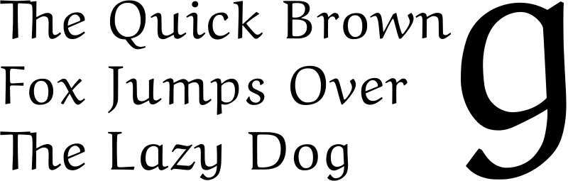
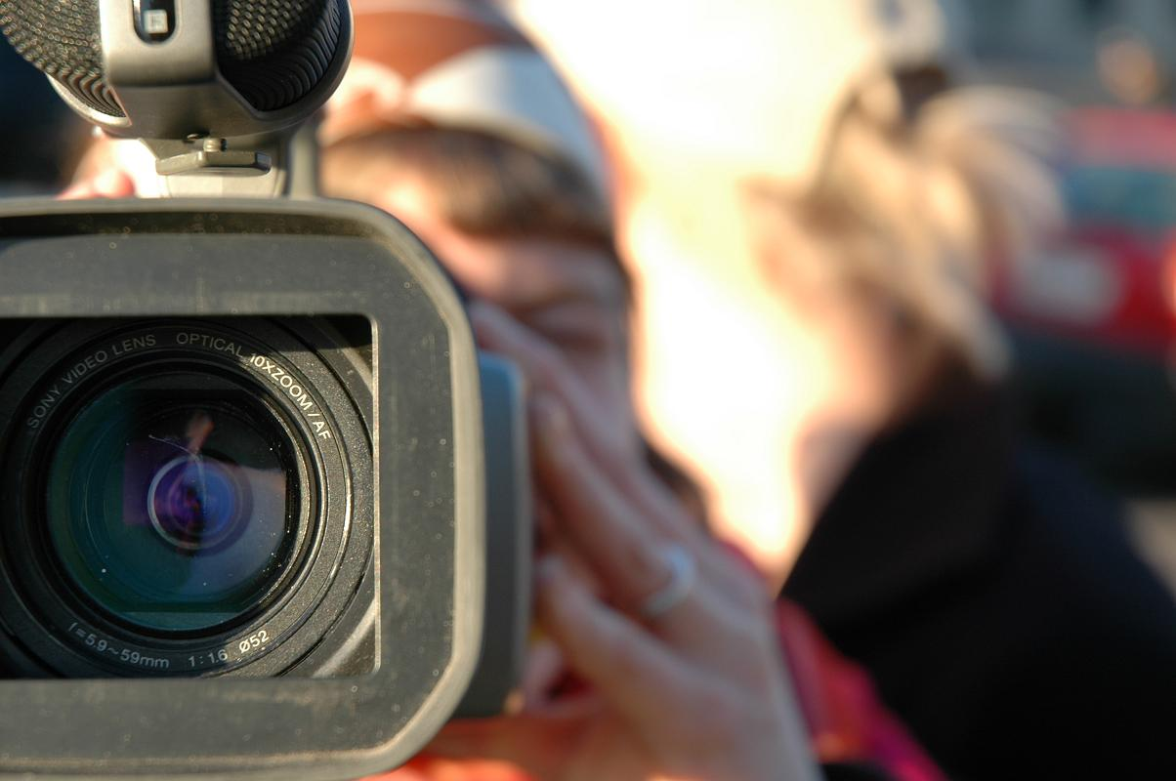
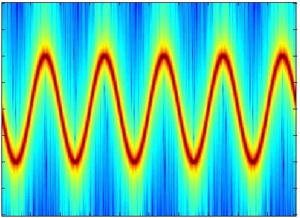
Notes:
Data can take many forms. It is so ubiquitous, it can often be overlooked.
Forms include: text, sound, still and moving images, models, games, simulations

Slide 13
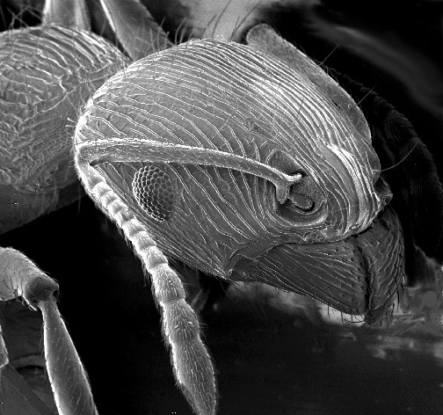
Notes:
Other forms include laboratory data, such as spectrographic data, genomic sequencing outputs and electron microscopy imagery.

Slide 14
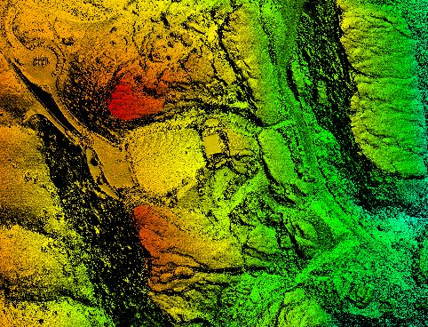
Notes:
Another sub-category is observational data, for instance remote sensing, geospatial and socioeconomic data

Slide 15
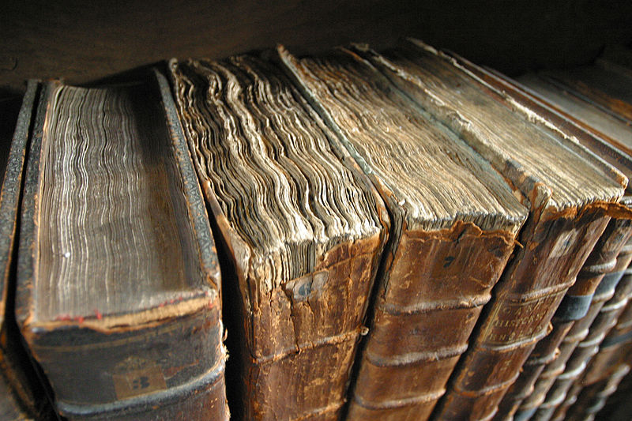
Notes:
And other types of digital data generated or compiled, by humans or machines.
Not to mention data in physical form.

Slide 16

Activity 1
What kinds of data will you be managing?
Notes:
ACTIVITY
On as many sticky notes as you need, write down the kinds of data you will be managing in your research project.
You might choose a project in the planning phase.
Or one you’re actively working on
Or just make one up!
I’ll give you 5 minutes after which we’ll do a quick lap of the room to find out what you’ve written down.
-
What you are beginning to create here is a data inventory - a critical resource in a world where data lives everywhere.

Slide 17
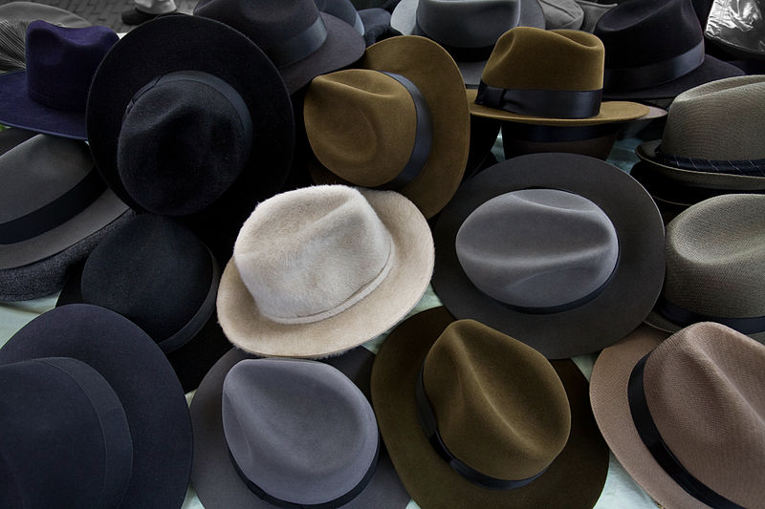
Collector | Ethics officer | Data Custodian
Checker of back ups | Validator | Licensor
Publisher | Promoter | Planner
Notes:
Now start to think about that data?
Who has a role to play in its creation, storage and publication?
Data brings with it many roles and responsibilities.
And a role without an owner implies a job that won’t get done!

Slide 18
“It is astonishing how little communication there is in the scientific community concerning planning of the project and talking about who is doing what,” says Ulrike Beisiegel, an ombudsman for the German Research Foundation in Hamburg. Without such planning, and a written agreement, scientists can find themselves in testy exchanges over paper authorship and data ownership. At best, these are rocky patches that can be smoothed over; at worst, such conflicts can lead to abandoned projects, wasted research funds and lawsuits.
— “Collaborations: With all good intentions”
Nature, 9 April 2008
Notes:
One crucial matter to nail down early is who owns the data.
Because once amicable collaborations can sometimes fall apart...

Slide 19
Activity 2
On a sticky note or two, spend 5 minutes noting down all the people who will have a role to play in managing your data.
What aspect is each responsible for?
Notes:
On a sticky note or two spend 5 minutes noting down all the people who have a role to play in managing your data.
If you’re visually minded, you might like to draw a network diagram.

Slide 20
Costing data management
Like any other research infrastructure, data management comes at a cost
Before | During | After
Your time | Your time | Your time
 | Storage costs Transcription Digitisation | Ongoing archival costs Hosting
Notes:
The last planning phase activity is costing your data management.
The benefit of budgeting early on is that you can allow for data management costs in your grant application.
As well saving you from a budget crisis, it has the benefit of underscoring your commitment to data management to the funding body.

Slide 21
To re-cap
During the planning stage, you should:
Get to know your data
Define roles and responsibilities
Estimate the costs involved
Where to get help
[TODO] Your eResearch Analyst
Your Research Data Coordinator
Notes:
To re-cap, the research planning stage is a great time to:
Get to know your data.
Define roles and responsibilities and get clear on ownership of the data.
Estimate the costs of data management.
For each of these you can get help from...

Slide 22
Conducting Research
2
2

Slide 23
While conducting research, you should:
Clarify your approach to data collection
Choose a robust form of storage
Ensure you can collaborate around data
Choose file formats wisely
Keep your data organised
Document your data
Ensure adequate security
Take care with sensitive data.

Slide 24
Data collection
What approach will I take to data collection?
Will my data be born digital? Can it be made to be?
Can I automate the collection process?
Is my data sensitive?
How will I validate my data?
Do I even need to collect my own data?
Notes:
The first thing you’ll want to think about is how you’re going to collect your data.
Here are a number of pertinent questions you can ask yourself…

Slide 25
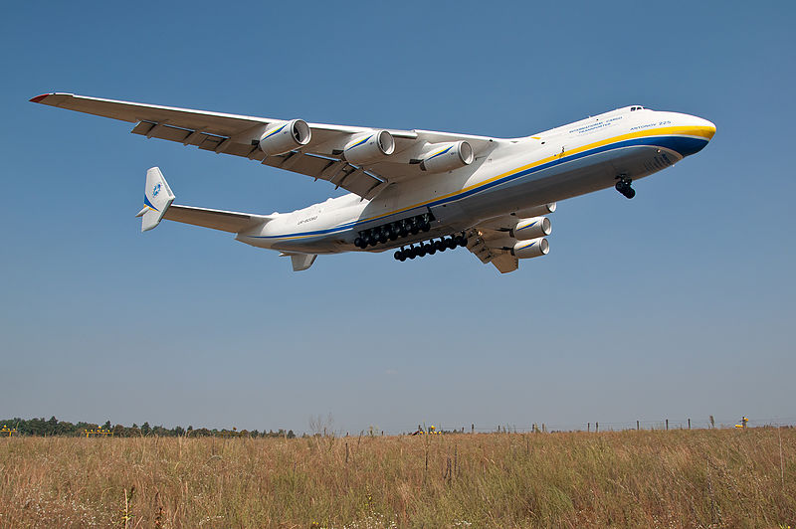
If using third party data, you’ll want to think about what terms and conditions apply to that data.
Notes:
The last question - Do I even need to collect my own data? - is becoming ever more pertinent.
An example from the world of “Big Data”. While conventional wisdom suggests that if you want to know the arrival time of an aircraft, you should ask the pilot, research has shown that pilots are not the best predictors of aircraft arrival time. By combining other data sources (such as weather conditions) they are able to use algorithms to produce more accurate predictions.
Similarly. At the outset of a research project, it’s worth asking the question whether you can obtain the data you need without having to ask your subjects. Can you use datasets already in existence? Can you mine Twitter and Facebook? Would this give you a bigger sample than if you were to survey a group directly?

Slide 26
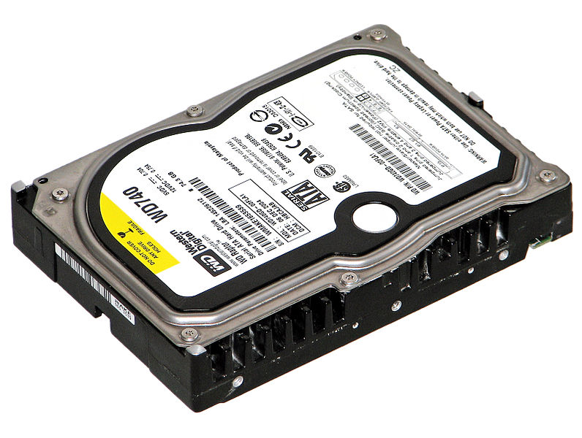
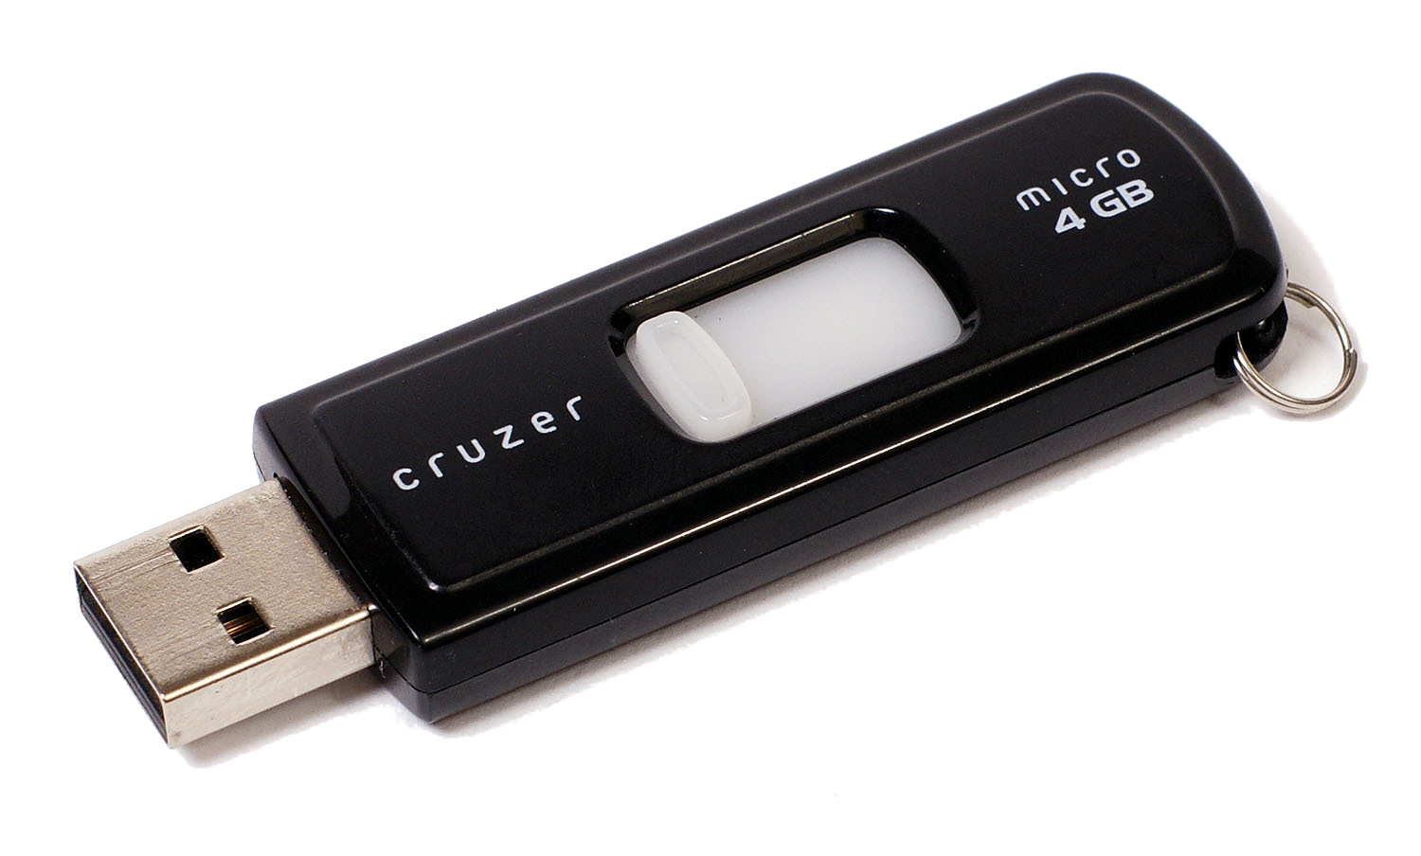
[TODO] Localise terminology and add any further local options
Network Drive
N: P: S: T: Z:
The “Cloud”
Notes:
Once you’ve firmed on your approach to data collection, the next question becomes where to store your data.
There are three common options:
Local storage - such as a hard drive or USB key
A network drive or share - as often provided by Universities
The Cloud - which is everything else, including but not limited to Dropbox, OneDrive, Google Drive, etc.
Let’s take a look at the pros and cons of each.

Slide 27
Durability
Network Drive
N: P: S: T: Z:
9/10
5/10
The “Cloud”
9/10
Notes:
In terms of durability USB keys, portable hard drives and desktop hard drives rate poorly. They are prone to physical damage (such as being dropped), failure and theft.
There is no redundancy in these forms of storage. If using these forms of storage, YOU need to make up for that lack of redundancy by making frequent backups.
Network drives and the Cloud fare much better in terms of durability because in most cases data is stored on higher grade equipment that has built in redundancy.

Slide 28
Collaborating with data
3
“More and more researchers are entering into collaborations, often with multiple members and in distant locations. Among the top 200 research universities in the United States, science and engineering publications involving multiple institutions increased 48% between 1988 and 2001”
— “Collaborations: With all good intentions”
Nature, 9 April 2008
Notes:
Another crucial factor determining where you store your data is collaboration.
The trend is that research is becoming ever more collaborative...

Slide 29
Collaboration
Network Drive
N: P: S: T: Z:
6.5/10
3/10
The “Cloud”
9/10
Notes:
Using hard drives and USB keys means your collaboration requires:
passing around USB keys, which may work OK locally.
emailing attachments around.
These practices make it hard to maintain a “source of truth” - a single copy of the data that all collaborators can access on demand.
Network drives are better, but they may not be suited to external collaborators, since access may only be for members of the University.
Cloud solutions often simplify sharing.

Slide 30
Security
Network Drive
N: P: S: T: Z:
8/10
4/10
The “Cloud”
8/10
Notes:
Another consideration is security, particularly in the case of storing confidential data.
Laptops, portable hard drives and USB keys typically provide poor security. They are vulnerable to theft and they can easily be left behind in places like airport lounges.
Simple steps, such as encrypting the data on these devices and password locking when not in use, can render the data incomprehensible to a thief.
(Of course if you forget the decryption password, your data becomes useless to you as well).
Network drives and Cloud options provide much better physical security, since your data resides in a data centre with highly restricted access.
However, when selecting Cloud options, particularly when storing confidential data, you should consider:
the terms and conditions of your Cloud storage provider. Do they claim any ownership over it?
the jurisdiction where your data will be stored.

Slide 31
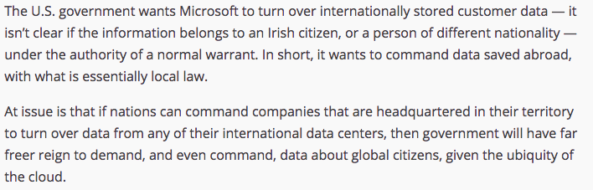
— TechCrunch http://tcrn.ch/1g30bHm
Notes:
The last point, the question of jurisdiction, may be particularly significant if you’re planning to store sensitive information.
There is a case currently playing out between the U.S. Government and Microsoft that illustrates the potential concerns…
-
The point is raised not to create panic. But rather to illustrate that amid the convenience that Cloud storage services bring there are some considerations that affect research data.

Slide 32
Retention
Network Drive
N: P: S: T: Z:
9/10
4/10
The “Cloud”
9/10
Notes:
Before we leave consideration of storage options, it’s worth considering retention requirements.
The Australian Code for the Responsible Conduct of Research notes: “In general, the minimum recommended period for retention of research data is 5 years from the date of publication.”
Computers get upgraded. Hard drives fail. USB keys get mislaid.
If using these media, you need to consider how to migrate your data, with every “tech refresh” that you do to ensure you meet the retention requirements.
If using a network drive or cloud storage, these tech refreshes will be done for you.

Slide 33
Storage
3
2
How much storage do I need?
How long do I need to keep it for?
Should I keep my data in the cloud?
Are there any legal or ethical restrictions on where the data can be stored?
Yes
No
Where to get help:
Where to get help
[TODO] Your eResearch Analyst
Notes:
So to recap. Some key questions when choosing where to store your data are...

Slide 34
Activity 3
For each dataset you noted in Activity 1, write down how much storage you think it’ll need over the life of the project.
Also note down where that data lives.
Notes:
ACTIVITY
For each dataset you noted in Activity 1, write down how much storage you think it’ll need over the life of the project.
Also note down where that data lives.
I’ll put up a slide that might help, if you’re having trouble estimating your storage.

Slide 35
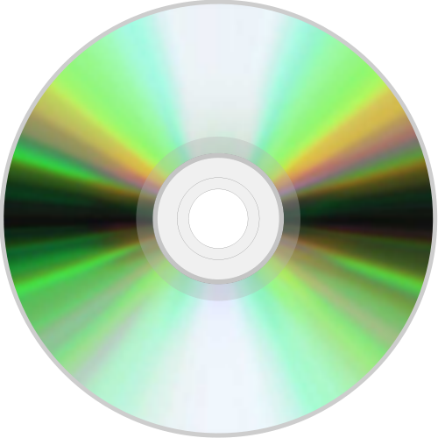
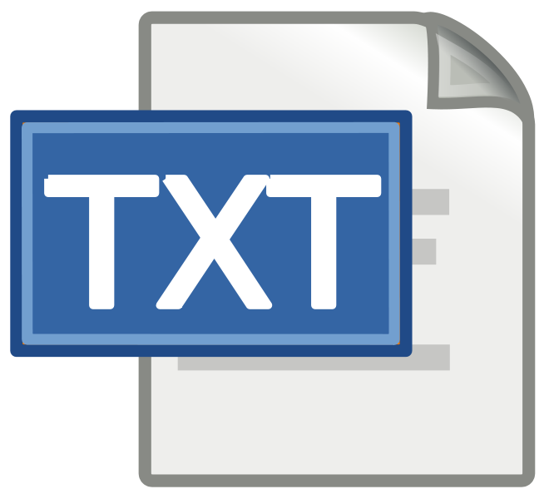
1 terabyte = 1000 gigabytes = 1mn megabytes
~166 hours
~1300 hours
~160,000
massive amounts
Notes:
In case you’re having trouble estimating your storage, consider the following:
1 terabyte will hold
a massive number of Word documents, Excel files, etc. since these tend to be small.
approximately 500,000 photos taken with a smartphone camera or about 160,000 images taken with a 20 megapixel DSLR camera.
about 1300 audio CD's worth of uncompressed, stereo audio.
about 166 hours of high quality video.
Note, however, these are just guidelines.
The storage required for audio, video and photos depends greatly on the quality and level of compression applied to the files.

Slide 36
… biologist Billy Hinchen returned one afternoon to find that his laptop and all his back-up hard drives had been stolen. All that remained was a disparate collection of data, spread around numerous small flash drives, email attachments and scribbled drawings that were difficult to piece together…
The knock-on effect was disastrous. As Billy put it: “I was focussed on creating high-resolution, 3D time-lapse videos of developing crustacean embryos, so all of my work was digital-based. When I lost my laptop and backups, I lost 400GB of data and close to four years of work…”
3
— “Research Information”, April/May 2014
Notes:
Now that your have your storage figured out, the question of backups arises.
Here are two horror stories to get you thinking!

Slide 37


Slide 38
Backups
3
2
How often, by whom, and where the backups will be stored?
How can I be sure my backups are working?
Where to get help
[TODO] Your eResearch Analyst
Where to get help:
Notes:
The problem with the term “backups” is that it can mean so many things.
They can be manual or automatic.
They can be full or incremental.
They can be onsite or offsite.
They might only capture the latest copy or might allow your to restore an earlier version.
They might or might not work!
Generally speaking, the greater the consequences of losing the data, the better the back up regime should be.
If in doubt about what kind of back ups apply to your data, ask!

Slide 39
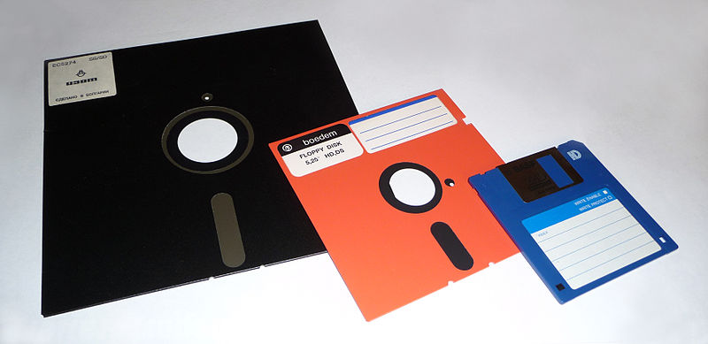
Obsolescence
Brewster Kahle, digital librarian and founder of the Internet Archive, knows the hassle of keeping digital files up to date in a time of rapidly changing technology. The San Francisco-based archive’s web collection, he said, contains more than 1 million video files alone, which have been moved into new file formats six times over the last decade. The process, Kahle said, is intended to ensure that the data remains relevant and accessible to people with “different devices and different expectations.”
— PBS Newshour
Notes:
Faulty hard drives, theft, and failed back ups are not the only ways data can be lost.
Obsolescence is a real risk. How many of us could easily read data on a floppy disk?
Consider the following...

Slide 40
Obsolescence
4
Choose Open formats where possible.
Store data in two formats for peace of mind!
Keep an archive of versions of software you’ve used.
Record the software version you used to create files.
DOC | CSV | NetCDF | JPEG
XLS | WAV | HFS5 | TXT
PDF | FLAC | PNG | XML
Notes:
Two facts:
File formats define the structure of a file. Some file formats are open, some are proprietary.
Software is versioned and not all versions are backwards compatible.
Here are some tips for avoiding being bitten by format obsolescence...

Slide 41
Organising files and folders
Former PhD student and subsequent founder of the Figshare platform, Mark Hahnel, typified a common challenge: ‘During my PhD I was never good at managing my research data. I had so many different file names for my data that I always struggled to find the correct file quickly and easily when it was requested. My former PI was so horrified upon seeing the state of my data organisation that she held an emergency lab book meeting with the rest of my group when l was leaving’.
— Research Information, April/May 2014
Notes:
Like obsolete file formats, hard drive crashes, and failed back ups, poor data organisation can also lead to data loss…

Slide 42
Organising files
Consistent, meaningful naming of files and folders can make everyone’s life easier
YYYYMMDD_SiteA_SensorB.CSV
Date collected
Location
Sensor
20150621_Yaouk_Humidity.CSV
Tip: Check for established conventions in your field
If creating your own, document them!
Notes:
Adopting a file naming convention can really help to keep your data organised.
Here we’re using dates written in year - month - day order so the files are sorted by date.

Slide 43

Organising folders
20150722 Namadgi Survey
README
01_As_Collected
Then throw in a “readme” to describe your folder layout right where it’s needed
02_Gap_Filled
03_Processed
04_For_Publication
Prefix with a number to force order by workflow steps
Notes:
Like files, folders too can follow a naming convention.
By prefixing with numbers, you can force your files to be ordered by the steps in your workflow.
Probably the simplest way to document your structure - for your future reference - is to add a “README” file - a text file outlining the contents of the folder.

Slide 44
Activity 4
Pick a dataset and illustrate how you currently organise your files.
(For the artists: Draw a picture that describes your current approach to file organisation)
See if you can devise a better naming convention.
Or note one or two improvements you could make to how you name your files
Notes:
ACTIVITY
Pick a dataset and illustrate how you currently organise your files.
For the artists: Draw a picture that describes your current approach to file organisation
See if you can devise a better naming convention.
Or note one or two improvements you could make to how you name your files

Slide 45







Taking it Further
Notes:
Files and folders are the most common ways that data is managed.
But other options exist. We’ll flag a few here today that you might want to investigate.
Version control systems such as Git and Subversion allow you to keep every version of a file. They originated out of a need within the software development community, but they are applicable to other activities where version tracking is required.
Then there are tools such as Omeka that allow you to build collections of data.
And there are a whole host of discipline specific eResearch tools and virtual laboratories that have been funded by NeCTAR.

Slide 46
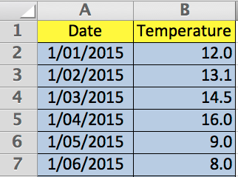
Data Documentation
6
Was that degrees Celsius, Fahrenheit, or Kelvin? ...
Notes:
We’ve already touched on data documentation, in relation to documenting file naming conventions, file formats and software versions.
Data documentation has some big picture elements - what project does this data belong to? But it also needs to capture fine grained elements as in the example shown...
Data documentation makes it possible to make sense of data in the future.
It can take many forms: readme files, publications, websites, blogs.
To be really useful it needs to be kept up-to-date.

Slide 47
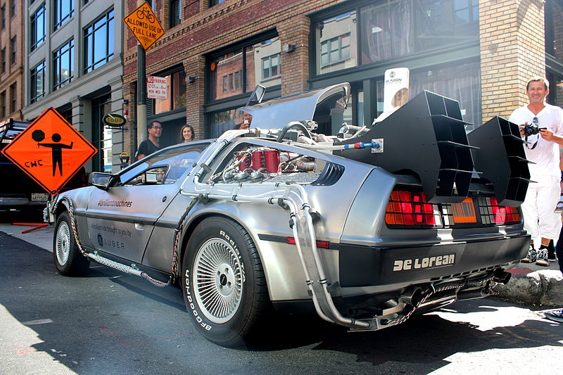
Activity 5
Flash forward 5 years.
What information about a dataset would you most value having in your possession?
Write it down on a sticky note.
Notes:
ACTIVITY
Flash forward 5 years.
What snippet of information about a dataset would you most value having in your possession?
Write it down on a sticky note.

Slide 48

Taking it Further
DC.Title | Intersect Australia Website
DC.Creator | Intersect Australia
DC.Subject | eResearch websites
DC.Description | ...largest full-service eResearch...
DC.Date | 2015-07-21
DC.Identifier | http://www.intersect.org.au/
Notes:
Any data documentation is better than no documentation.
But structured data documentation is even better, since it is interchangeable, machine readable, searchable, and is based on a common understanding.
This is called “metadata”. Data about data.
Emerging all the way back in 1995, the Dublin Core standard gives a good general sense of what metadata is trying to achieve...

Slide 49
To re-cap
During the active research phase you should:
Clarify your approach to data collection
Choose a robust form of storage
Ensure you can collaborate around data
Choose file formats wisely
Keep your data organised
Document your data
Ensure adequate security
Take care with sensitive data.

Slide 50
Post-Research
3
Notes:
Now we come to the last part of this training session, where we consider what to do with your data after your research is completed.

Slide 51
Before a research project reaches completion, you should:
Enable reuse
Decide how you’ll licence your data
Anonymise data, if required
Decide how and where to publish your data
Make your data easy to cite
Promote your data

Slide 52
Why enable reuse?
Agricultural researcher Melvin McCarty, for instance, spent 15 years between 1958 and 1973 recording the life cycles of plants and grasses near Lincoln, Nebraska. Forty years later, ecologist Lizzie Wolkovich went searching for McCarty’s data as part of an effort to tie together experiments exploring how rising temperatures affect plant life cycles. But McCarty had died, and his raw data could not be found. “There is nothing we can replicate now. The loss of the long-term data set is very sad,” says Wolkovich, who works at the University of British Columbia in Vancouver.
— Nature, 19th December 2013
Notes:
Of course the first question might be, “why enable reuse?”
Here are a couple of examples to get you thinking...

Slide 53


Slide 54
Why enable reuse?
Altmetrics
Career building
The greater good
Simplify own reuse
Analogy with blogging
Notes:
And here are some other reasons…
Be well positioned for the rise of altmetrics - measures other than journal impact factors and h-indexes.
Build your profile by having your data used and cited by others.
Do something to help humankind!
Simplify your own reuse by putting your data somewhere where you and others can find it.
Think of it like blogging - sharing what’s useful to you because sharing is no longer the hard part.

Slide 55
Activity 6 - Part 1
Write down three things that currently stop you from sharing your research data
Notes:
ACTIVITY
Write down three things that currently stop you from sharing your research data.

Slide 56
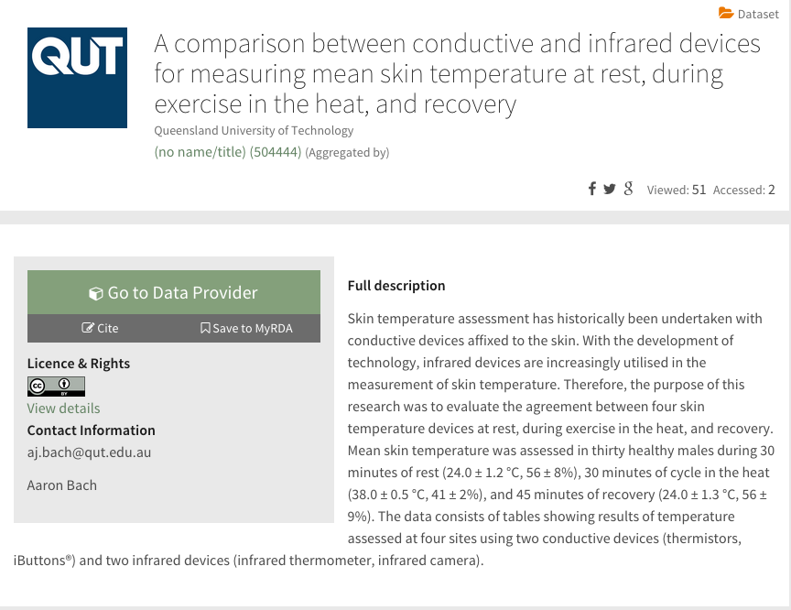
28
Notes:
So how do we enable reuse?
We’ll for data to be reusable it has to be described and discoverable.
Here is a record from ANDS’ Research Data Australia service.
It illustrates what’s required in order for others to discover, make use of your data, and give you due recognition for it.
Let’s unpack this record.

Slide 57
28
Notes:
The first thing to decide is how you want to make your data available.
You could publish it to a research data repository.
You could publish it to a data journal.
You could publish it on your website or blog.
Or choose to make the data available on request.

Slide 58







ANDS Guide: Data Journals
http://bit.ly/1LxtltB
Notes:
How do you discover repositories where you can publish your data?
re3data.org an international database of data repositories.
In addition, here are some data archives and journals….

Slide 59
28
Notes:
Next you’ll want to consider how to handle enquiries about your data.
We talked about roles and responsibilities. “Contact person” is just another role.

Slide 60
28
Notes:
Next you should decide how you’d like your data cited. This is important in giving you the recognition you deserve.
You can set the expectation for how your data will be referenced.
Some repositories and discovery services will already have citation conventions.
Some services can create a DOI - a digital object identifier - to uniquely reference your dataset.

Slide 61
Bach, Aaron (2014): A comparison between conductive and infrared devices for measuring mean skin temperature at rest, during exercise in the heat, and recovery. figshare. http://dx.doi.org/10.6084/m9.figshare.1254250
Notes:
Data citation is an emerging field.
DataCite is a service that can help.
Here is an example citation.
Note the DOI - the digital object identifier.

Slide 62
28
Notes:
Next, you’ll want to consider licensing.
Here’s where you are rewarded for considering ownership earlier.
Licensing empowers you to stipulate what kinds of reuse are acceptable.
Licensing empowers other researchers to confidently reuse your data

Slide 63
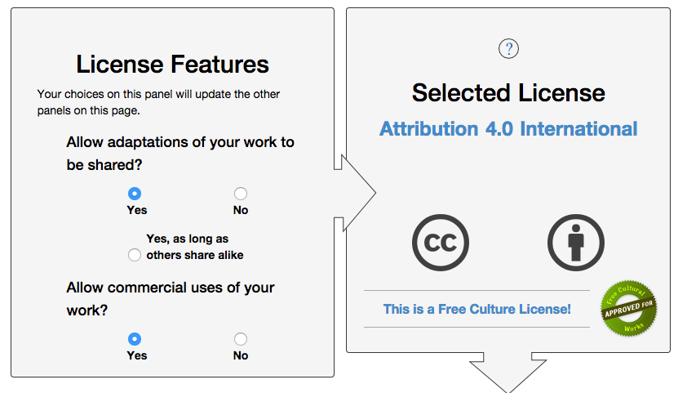
Where to get help
[TODO] Research Data Coordinator
Copyright Officer
ANDS Guide http://bit.ly/1CSGnR1
Notes:
Licensing is a complex topic.
But it is getting easier to navigate, with licenses such as Creative Commons allowing you to set your parameters and generate a license.
ANDS have an excellent guide.
And there are local places to get help.

Slide 64
28
Notes:
The last thing required for enabling data reuse is good data documentation.
We’ve already talked about that earlier.
But it’s worth underscoring that the effort you make in describing the data to improve your own research will also be to the benefit of others.

Slide 65

Notes:
Let’s now consider some common barriers to sharing and reuse.

Slide 66
No one would be interested
It’s not good enough
Why would anyone want this?
I’ll never use it again
Notes:
...chances are that if you find it useful, others will too. And in ways never imagined by you.

Slide 67
Problem: I want to be the first to publish
Solution:
You can opt to make just a description of your data available.
You can opt to make your data available on request.
You can set an embargo period.
Notes:
Making your data needn’t be an all or nothing affair.
You can set the ground rules under which you make your data available.

Slide 68
Problem: My data is confidential
One way to make otherwise sensitive data available for re-use is to anonymise it.
In doing so, you need to be careful to ensure that individuals cannot be re-identified.
Tip: Right at the start of the project, negotiate informed consent that permits reuse by you and by others.
Publishing and Sharing Sensitive Data
http://bit.ly/1IdsZaF

Slide 69
Activity 6 - Part 2
Discussion
Notes:
ACTIVITY
Share your thoughts about sharing your data.

Slide 70
To re-cap
In this last section we have considered how to enable data reuse. We’ve briefly touched on:
Good reasons to share data.
Common reasons not to share data.
Deciding how and where to publish your data.
Making your data easy to cite.
Deciding how you’ll licence your data.
Where to get help
[TODO] Your Research Data Coordinator
Research Services
Where to get help:

Slide 71
Today
1
2
3
Planning Research | Conducting Research | Post-Research
data collection
storage
collaboration
obsolescence
organisation
documentation
security
sensitive data
know your data
roles and responsibilities
costs
enabling reuse
publishing data
citing data
licensing
sensitive data
Notes:
That brings us to the end of our session today.
We’ve covered a lot of ground...

Slide 72
Plan for Success
Notes:
What today has shown, hopefully, is that research data needs to be managed.
Like so many things in life, a little up front planning can open the door to benefits while avoiding significant setbacks.
Take your sticky notes with you, because they will form the basis of an excellent data management plan.

Slide 73
Thank you
[TODO] Insert Link to Evaluation Survey
Where to get help
[TODO] Your Research Data Coordinator
Your eResearch Analyst
Management and Storage of Research Data and Materials Policy
Open Access to Research Publications and Data Policy
Notes:
Thank for your time today. We would really value to your feedback on this session.

Slide 74
We wish to give due attribution to the following images, licensed under Creative Commons and released to the Public Domain, used within this presentation:
https://commons.wikimedia.org/wiki/File:Edison_Lightbulb_Drawings_2_Mus%C3%A9e_des_Lettres_et_Manuscrits.jpg
https://commons.wikimedia.org/wiki/File:Grand_Turk(34).jpg
https://commons.wikimedia.org/wiki/File:DNA_Sequencing_Cost_per_Genome_Over_Time.jpg
https://commons.wikimedia.org/wiki/File:Orange-Fruit-Pieces.jpg
https://en.wikipedia.org/wiki/File:AMS_Euler_sample_text.svg
https://commons.wikimedia.org/wiki/File:Video_Camera.JPG
https://upload.wikimedia.org/wikipedia/commons/2/2b/VariableFrequency.jpg
https://commons.wikimedia.org/wiki/File:Ant_SEM.jpg
https://commons.wikimedia.org/wiki/File:Digital_Elevation_Model_-_Red_Rocks_Amphitheater,_Colorado.jpg
https://commons.wikimedia.org/wiki/File:Old_book_bindings.jpg
https://commons.wikimedia.org/wiki/File:Game_of_life_fpento.svg
https://commons.wikimedia.org/wiki/File:Amsterdam_-_Hats_-_0931.jpg
https://commons.wikimedia.org/wiki/File:Antonov_An-225_landing_at_Gostomel_Airport.jpeg
https://commons.wikimedia.org/wiki/File:Hard_disk_Western_Digital_WD740_1_(dark1).jpg
https://commons.wikimedia.org/wiki/File:SanDisk_Cruzer_Micro.png
https://commons.wikimedia.org/wiki/File:Compact_disc.svg
https://commons.wikimedia.org/wiki/File:Floppy_disk_2009_G1.jpg
https://commons.wikimedia.org/wiki/File:Delorean_DMC-12_Time_Machine_in_San_Francisco.JPG
https://commons.wikimedia.org/wiki/File:FA-18_Hornet_breaking_sound_barrier_(7_July_1999)_-_filtered.jpg

